Slide 1
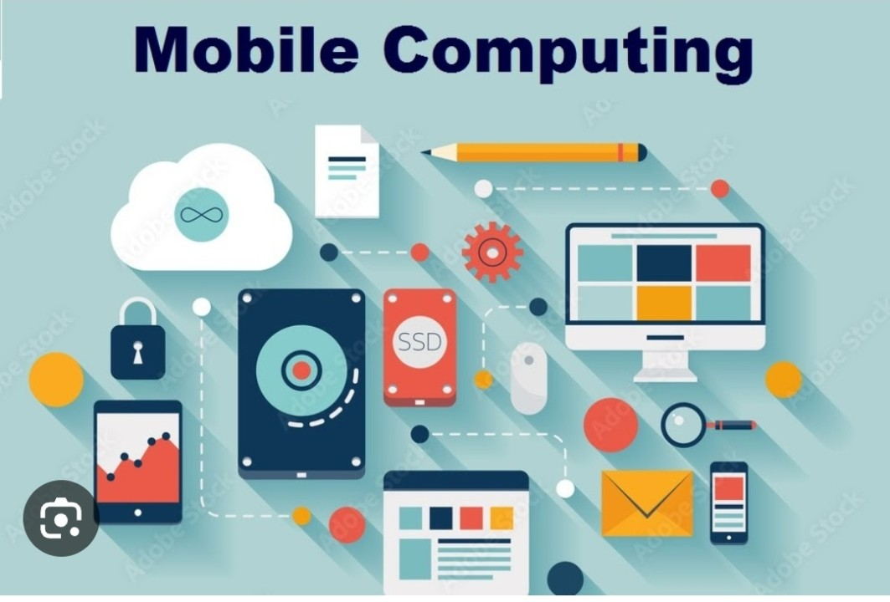
U20ITCM02 – Mobile computing III Year / V Semester T.Maheshwaran, Assistant Professor, Department of IT,SMVEC

Slide 2
Course Outcomes
CO1 - Explain the basics of mobile telecommunication system(K2)
CO2 - Articulate the required functionality at each layer for given
application(K2)
CO3 - Identify solution for all functionality at each layer. (K1)
CO4 - Use simulator tools and design Ad hoc networks(K3)
CO5 - Develop a mobile application(K6)

Slide 3
Syllabus
UNIT I INTRODUCTION
Mobile Computing – Mobile Computing Vs Wireless Networking – Mobile Computing Applications – Characteristics of Mobile computing – Structure of Mobile Computing Application. MAC Protocols – Wireless MAC Issues – Fixed Assignment Schemes – Random Assignment Schemes – Reservation Based Schemes.
UNIT II MOBILE INTERNET PROTOCOL AND TRANSPORT LAYER
Overview of Mobile IP – Features of Mobile IP – Key Mechanism in Mobile IP – route Optimization. Mobile TCP– WAP – Architecture – WDP – WTLS – WTP –WSP – WAE – WTA Architecture – WML
UNIT III MOBILE TELECOMMUNICATION SYSTEM
Global System for Mobile Communication (GSM) – Services & Architecture- Protocol-Connection Establishment – General Packet Radio Service (GPRS) – Universal Mobile Telecommunication System (UMTS) – Handover - Security.
UNIT IVMOBILE AD-HOC NETWORKS
Ad-Hoc Basic Concepts – Characteristics – Applications – Design Issues – Routing Popular Routing Protocols– Vehicular Ad Hoc networks (VANET) – MANET Vs VANET – Security.
UNIT V MOBILE PLATFORMS AND APPLICATIONS
Mobile Device Operating Systems – Special Constrains & Requirements – Commercial Mobile Operating Systems – Software Development Kit: iOS, Android, BlackBerry, Windows Phone – M- Commerce – Structure – Pros & Cons – Mobile Payment System – Security Issues.

Slide 4
Textbooks & References
Text Books
Prasant Kumar Pattnaik, Rajib Mall, “Fundamentals of Mobile Computing”, PHI Learning Pvt. Ltd, New Delhi – 2012.
Jochen H. Schller, “Mobile Communications”, Second Edition, Pearson Education, New Delhi, 2007
C.K.Toh, “AdHoc Mobile Wireless Networks”, First Edition, Pearson Education, 2002.
Reference Books
Dharma Prakash Agarval, Qing and An Zeng, “Introduction to ILJIJHJIJJWireless and Mobile systems”, Thomson Asia Pvt Ltd, 2005.
William.C.Y.Lee,“Mobile Cellular Telecommunications-Analog and Digital Systems”, Second Edition,TataMcGraw Hill Edition ,2006.
UweHansmann, LotharMerk, Martin S. Nicklons and Thomas Stober, “Principles of Mobile Computing”, Springer, 2003.
Web References
Developers : http://developer.android.com/index.html
Apple Developer : https://developer.apple.com/
Windows Phone DevCenter: http://developer.windowsphone.com 9. BlackBerry Developer : http://developer.blackberry.com/

Slide 5
UNIT I INTRODUCTION
Mobile Computing – Mobile Computing Vs wireless Networking – Mobile Computing Applications – Characteristics of Mobile computing – Structure of Mobile Computing Application. MAC Protocols – Wireless MAC Issues – Fixed Assignment Schemes – Random Assignment Schemes – Reservation Based Schemes.

Slide 6
What is Mobile Computing?
What is computing?
The capability to automatically carry out certain processing related to service invocations on a remote computer .
What is the mobility ?
The capability to change location while communicating to invoke computing service at some remote computers.
What is mobile computing?
Ability to compute remotely while on the move. It is possible to access information from anywhere and at anytime.

Slide 7

A simple definition could be: Mobile Computing is using a computer (of one kind or another) while on the move
Another definition could be: Mobile Computing is when a (work) process is moved from a normal fixed position to a more dynamic position.
A third definition could be: Mobile Computing is when a work process is carried out somewhere where it was not previously possible.
Mobile Computing is an umbrella term used to describe technologies that enable people to access network services anyplace, anytime, and anywhere.

Slide 8
Mobile computing vs Wireless networking
Mobile computing is based on wireless networking and helps to invoke computing services on remote servers while on the move.
So Wireless networking is an important and necessary ingredient of mobile computing.
Mobile computing also requires the applications themselves – their design and development, the hardware at the client and server sides

Slide 9
Classification of Wireless networks
Wireless networks can be classified into basic types
Infrastructure network -One is extension of wired networks. It uses fixed infrastructure such as base station to provide single hop wireless communication with wired network as shown.
Two-hop cellular communication as shown.

Slide 10
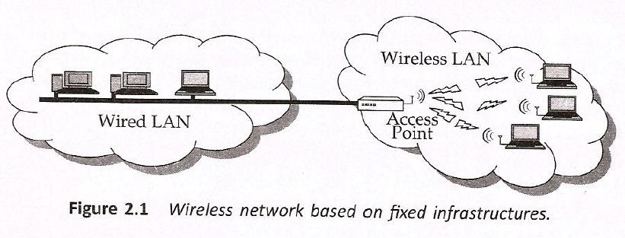
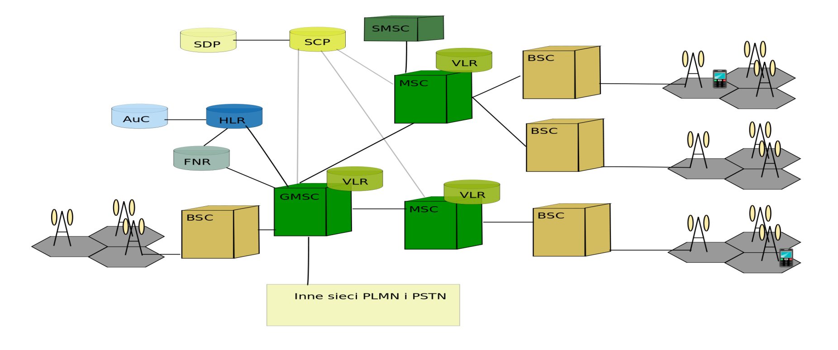
Figure 3- Two-hop cellular communication

Slide 11
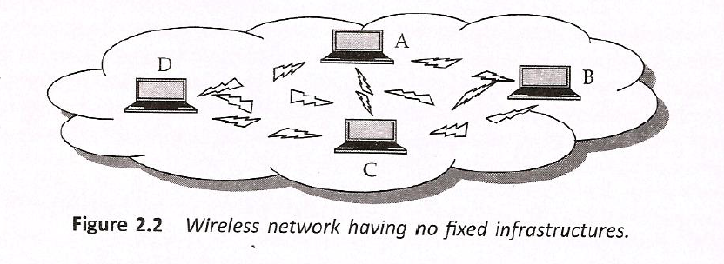
Ad Hoc network It does not use any fixed infrastructure and is based on multi-hop wireless communication as show.

Slide 12
Applications of Mobile Computing
Stock Information Collection/Control
Emergency services
For Estate Agents
In courts
In companies
Credit Card Verification
Taxi/Truck Dispatch
Electronic Mail/Paging

Slide 13
Applications Conti…
Vehicles
transmission of news, road condition, weather, music via DAB
personal communication using GSM
position via GPS
local ad-hoc network with vehicles close-by to prevent accidents, guidance system, redundancy
vehicle data (e.g., from busses, high-speed trains) can be transmitted in advance for maintenance
Medical
Nurses/Doctors in Medical offices are now using Wireless Tablet PCs/WLAN to collect and share patient information.
Sales
Sales representatives are using Tablet PCs with Smart phones for presentation, transmitting/access information among office, hotel, and customer location.
Emergencies
Early transmission of patient data to the hospital, current status, first diagnosis
Provide mobile infrastructure in dealing with Natural Disaster (earthquake, hurricane, fire), terrorist attacks, war, ...

Slide 14

Characteristics of Mobile Computing
Ubiquity – The ability of a user to perform computation from anywhere and at anytime.
Location awareness – Many applications requires or value additions by location based services.
Adaptation- Ability to adjust to bandwidth fluctuations without inconveniencing the user.

Slide 15
Broadcast- Efficient delivery of data can be made simultaneously to hundreds of mobile users
Personalization – Services in a mobile environment can be easily personalized according to a user’s profile.

Slide 16
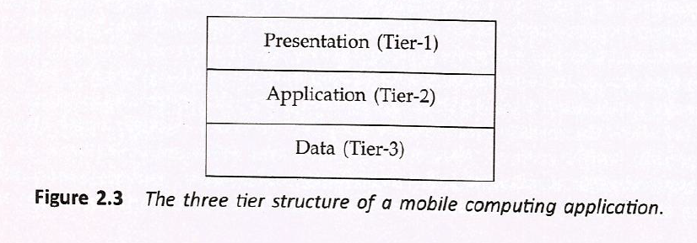
Structure of Mobile Computing Application
A mobile computing application is usually structured In terms of the functionalities implemented .
As shown in the figures 2.3 and 2.4 the three tiers are named presentation tier, application tier and data tier.

Slide 17
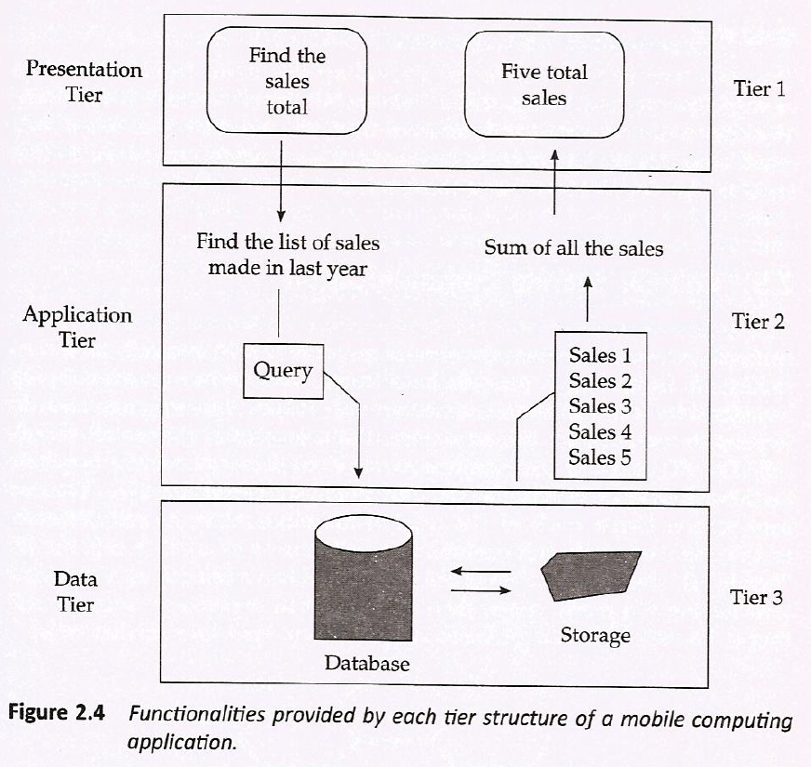

Slide 18
Presentation tier – The topmost level, concerns the user interface. It facilitates the users to issue requests and to present the results meaningfully. It includes web browsers and client programs.
Application tier – It is responsible for making logical decisions and performing calculations. Implemented using Java, .NET services, cold fusion etc. Implemented on a fixed server.
Data tier – Responsible for data storage, access and manipulation. Implemented on a fixed server.

Slide 19
MEDIA ACCESS CONTROL(MAC)
Media access control (MAC) protocols enforce a methodology to allow multiple devices access to a shared media network.
The primary task of any MAC protocol is to control the access of the nodes to shared medium.
MAC protocol is the sublayer of datalink layer (or) first protocol layer above the Physical Layer

Slide 20
MEDIA ACCESS CONTROL(MAC)
It is responsible for flow control and multiplexing for transmission medium.
It controls the transmission of data packets via remotely shared channels.
It sends data over the network interface card.

Slide 21
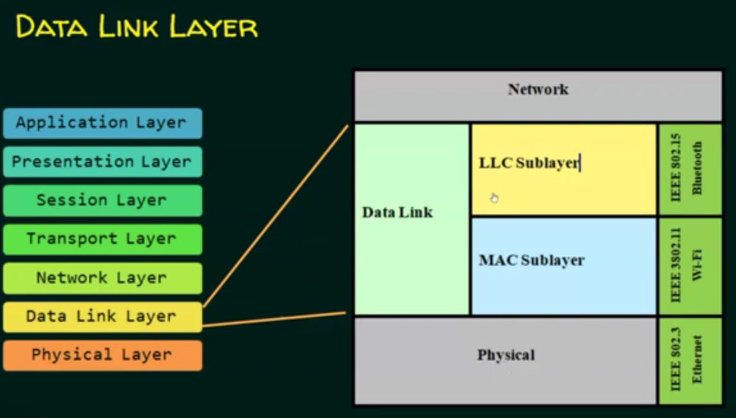
MEDIA ACCESS CONTROL(MAC)

Slide 22
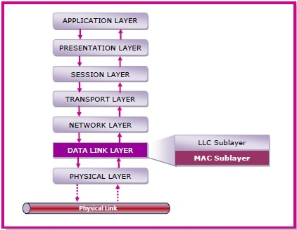
MAC Layer in the OSI Model
The data link layer is the second lowest layer. It is divided into two sublayers −
The logical link control (LLC) sublayer
The medium access control (MAC) sublayer
The following diagram depicts the position of the MAC layer −
.

Slide 23
MAC LAYER FUNCTIONS
It is responsible for encapsulating frames so that they are suitable for transmission via the physical medium.
It resolves the addressing of source station as well as the destination station, or groups of destination stations.
It performs multiple access resolutions when more than one data frame is to be transmitted. It determines the channel access methods for transmission.
It also performs collision resolution and initiating retransmission in case of collisions.
It generates the frame check sequences and thus contributes to protection against transmission errors.
.

Slide 24
MAC ADDRESS
MAC address or media access control address is a unique identifier allotted to a network interface controller (NIC) of a device.
It is used as a network address for data transmission within a network segment like Ethernet, Wi-Fi, and Bluetooth.
MAC address is assigned to a network adapter at the time of manufacturing. It is hardwired or hard-coded in the network interface card (NIC).
A MAC address comprises of six groups of two hexadecimal digits, separated by hyphens, colons, or no separators. An example of a MAC address is 00:0A:89:5B:F0:11.
.

Slide 25
A Taxonomy (classification) of MAC Protocols
A large number of MAC protocols have been proposed. These MAC protocols can be broadly divided into the following three categories:
Fixed assignment schemes
Random assignment schemes
Demand-based schemes
.

Slide 26
Classification of wireless MAC protocols
Wireless MAC protocols
Fixed-assignment schemes
Random-access schemes
Reservation - based schemes
Circuit-switched
CL packet-switched
CO packet-switched
CL – Connection Less. CO – Connection Oriented

Slide 27
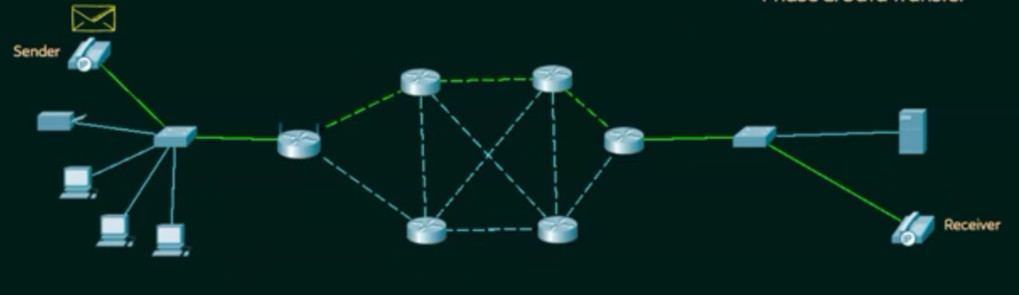
Circuit switching

Slide 28
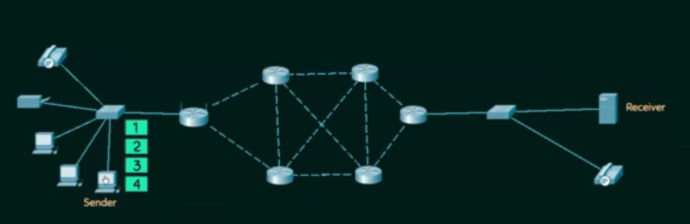
Packet switching

Slide 29
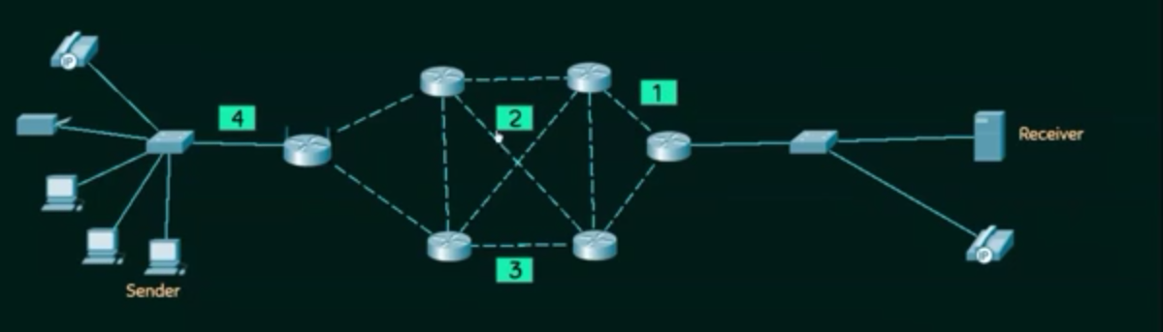
packet switching

Slide 30
CIRCUIT SWITCHING
Circuit switching is a switching technique that establishes a dedicated path between sender and receiver.
Before data transfer connection will be established first. Once the connection established between two parties, it will be available till end of the conversation
The channel is reserved between the users till the connection is active
EXAMPLE: TELEPHONE COMMUNICATION
.

Slide 31
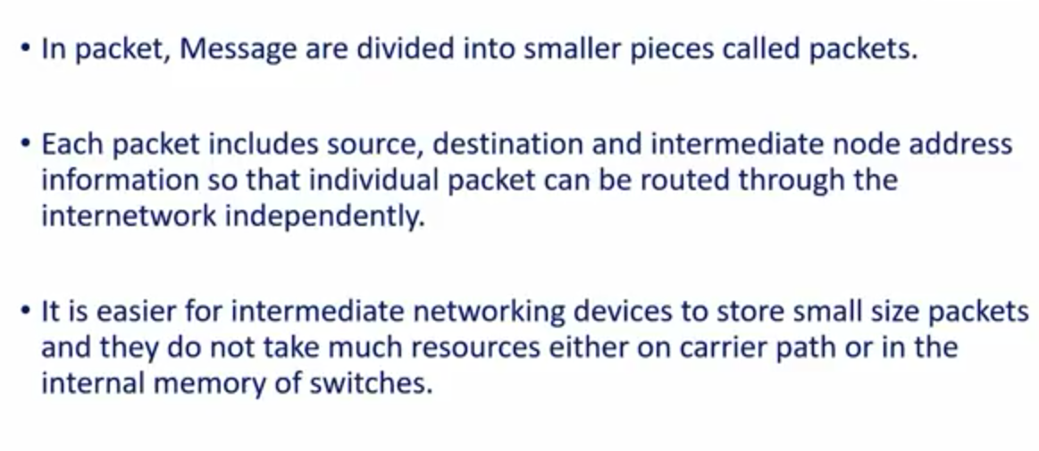
packet switching

Slide 32
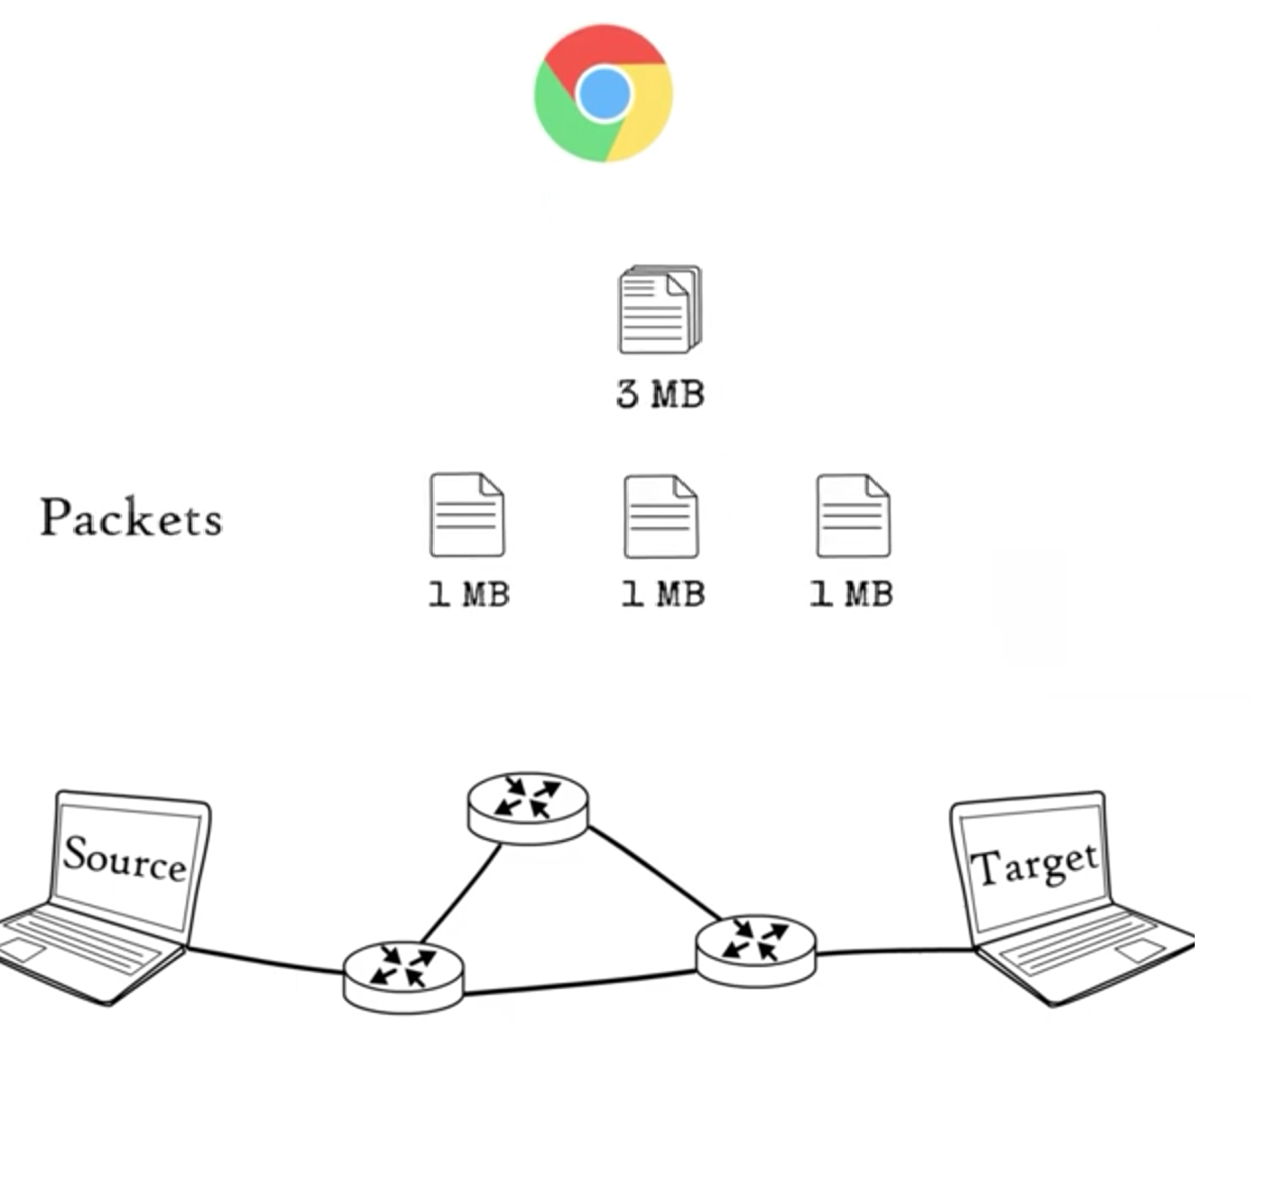
Packet Switching

Slide 33
Classification of wireless MAC protocols
Wireless MAC protocols
Fixed-assignment schemes
Random-access schemes
Reservation - based schemes
Circuit-switched
CL packet-switched
CO packet-switched
CL – Connection Less. CO – Connection Oriented

Slide 34
Fixed assignment schemes
A few important categories of fixed assignment MACprotocols are the following:
Frequency Division Multiple Access (FDMA)
Time Division Multiple Access (TDMA)
Code Division Multiple Access (CDMA)
.

Slide 35
Channel Partitioning MAC protocols
TDMA: Time Division Multiple Access
Example:
Frequency
4 users
time
FDMA: Frequency Division Multiple Access
Frequency
time
CDMA: Code Division Multiple Access
Same frequency and time but different codes.

Slide 36
Frequency Division Multiple Access (FDMA)
In FDMA, the available bandwidth (frequency range) is divided into many narrower frequency bands called channels.
Figure 3.4 shows a division of the existing bandwidth into many channels (showns as Ch 1, Ch 2, etc.).
For full duplex communication to take place, each user is allocated a forward link (channel) for communicating from it (mobile handset) to the base station (BS), and a reverse channel for communicating from the BS to it.

Slide 37
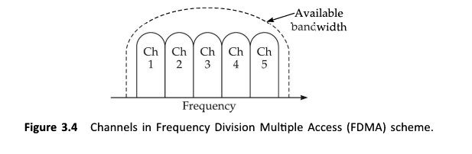
Frequency Division Multiple Access

Slide 38
Frequency Division Multiple Access (FDMA)
Thus, each user making a call is a11ocated two unique frequency bands (channels), one for transmitting and the other for receiving signals during the call
Obviously, when a call is underway, no other user would be allocated the same frequency band to make a call.
Unused transmission time in a frequency band that occurs when the allocated caller pauses between transmissions, or when no user is allocated a band, goes idle and is wasted. FDMA, therefore, does not achieve a high channel uti1ization.

Slide 39
FDMA
Frequency
Channel
Time

Slide 40
Time Division Multiple Access (TDMA)
TDMA is an access method in which multiple nodes are allotted different time s1ots to access the same physical channe1.
That is, the timeline is divided into fixed-sized time slots and these are divided among mu1tip1e nodes who can transmit. Note that in this case, all sources use the same channel, but take turns in transmitting.
the situation where time slots are allocated to users in a round robin manner, with each user being assigned one time slot per frame.

Slide 41
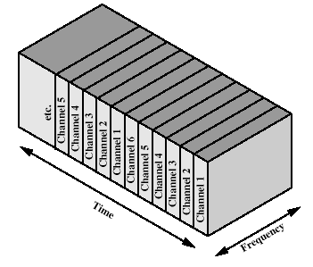
Time-division multiplexing

Slide 42
Code Division Multiple Access(CDMA)
In CDMA, multiple users are allotted different codes that consist of sequences of 0 and 1 to access the same channe1.
As shown in Fig. 3.6, a special coding scheme is used that a11ows signals from mu1tip1e users to be multiplexed over the same physical channel.
Multiple users use the same frequency at the same time.
All the senders send signals simultaneously.

Slide 43
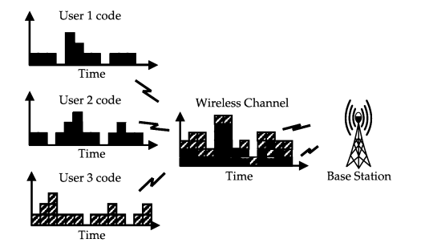
CDMA

Slide 44
Classification of wireless MAC protocols
Wireless MAC protocols
Fixed-assignment schemes
Random-access schemes
Reservation - based schemes
Circuit-switched
CL packet-switched
CO packet-switched
CL – Connection Less. CO – Connection Oriented

Slide 45
Random access MAC Schemes
Number of random assignment schemes . A few important.
ALOHA
Slotted ALOHA
CSMA
CSMA/CD
CSMA/CA

Slide 46
ALOHA
Simplest scheme
True free-for-all. When a node needs to send, it does so.
It listens for an amount of time equal to the maximum round trip delay plus a fixed increment.
If it hears an acknowledgment, fine; otherwise it resends after waiting a random amount of time.
After several attempts, it gives up.
Low delay if light load
Max. utilization: 18%

Slide 47
Slotted ALOHA
An improvement over pure ALOHA.
Time is divided into equal sized slots in which a packet can be sent. The size of pocket is restricted.
Send packet only at the beginning of a slot.
Employ beacon signals to mark the beginning of a slot.
Does not work well if the number of stations contending to send data is high.
In such case CSMA scheme works better.

Slide 48
Carrier Sense Multiple Access CSMA
Carrier Sense Multiple Access
sense carrier
if idle, send
wait for ack
If there isn’t one, assume there was a collision, retransmit
Vulnerable period: one t_{prop}

Slide 49
Extension of CSMA
The extension of CSMA are the collision detection CSMA/CD and the collision avoidance CSMA/CA techniques.
Why CA and CD?
Difficult to detect collisions in a radio environment – why?
A transmitting station cannot effectively distinguish incoming weak signals from noise and the effects of its own transmission; need a full duplex radio to listen and transmit on same frequency (not true in FDD systems)
Hidden station problem:
Two mutually far away stations A and C want to send to B.
At A and C, channel appears idle
But collision occurs at B

Slide 50
CSMA/CD
CSMA/CD multi-access control protocol.
Each station listens before it transmits.
If the channel is busy, it waits until the channel goes idle, and then it transmits.
If the channel is idle it transmits immediately. Continue sensing.
If collision is detected, transmit a brief jamming signal, then cease transmission, wait for a random time, and retransmit.
collision detection is not by waiting for an ACK

Slide 51
CSMA/CA
Prevent collision at the moment they are most likely occur, when bus is released after a packet transmission.
During the time a node is transmitting on the channel, several nodes might be wanting to transmit and waiting for it to become free.
The moment the transmitting node completes its transmission and would all starts transmitting at the same time.
To overcome in the collision avoidance scheme, all nodes are forced to wait for a random time and then sense the medium again before starting their transmission.
If the medium is sensed to be busy, further random amount of time and so on.
Thus the chance of two nodes starting to transmit at the same time would be greatly reduced.

Slide 52
Classification of wireless MAC protocols
Wireless MAC protocols
Fixed-assignment schemes
Random-access schemes
Reservation - based schemes
Circuit-switched
CL packet-switched
CO packet-switched
CL – Connection Less. CO – Connection Oriented

Slide 53
Reservation based schemes
Basic form of the reservation scheme is RTS/CTS scheme.
A sender transmits an RTS (Ready to Send) packet to the receiver before the actual data transmission.
On receiving this the receiver sends CTS (Clear to Send) packet.
The actual data transfer commences only after that.
The other nodes sharing the medium sense the CTS packet, they refrain from transmitting until the transmission from the sending node is completes.

Slide 54
Contention-based protocol
MACA(Multiple Access Collision Avoidance) Protocol
MACA solves the hidden/ exposed terminal problems
When a node wants to transmit a data packet, it first transmit a RTS (Request To Send) frame.
The receiver node, on receiving the RTS packet, if it is ready to receive the data packet, transmits a CTS (Clear to Send) packet.
Once the sender receives the CTS packet without any error, it starts transmitting the data packet.
If a packet transmitted by a node is lost, the node uses the binary exponential back-off (BEB) algorithm to back off a random interval of time before retrying.
The binary exponential back-off mechanism used in MACA might starves flows sometimes. The problem is solved by MACAW.

Slide 55
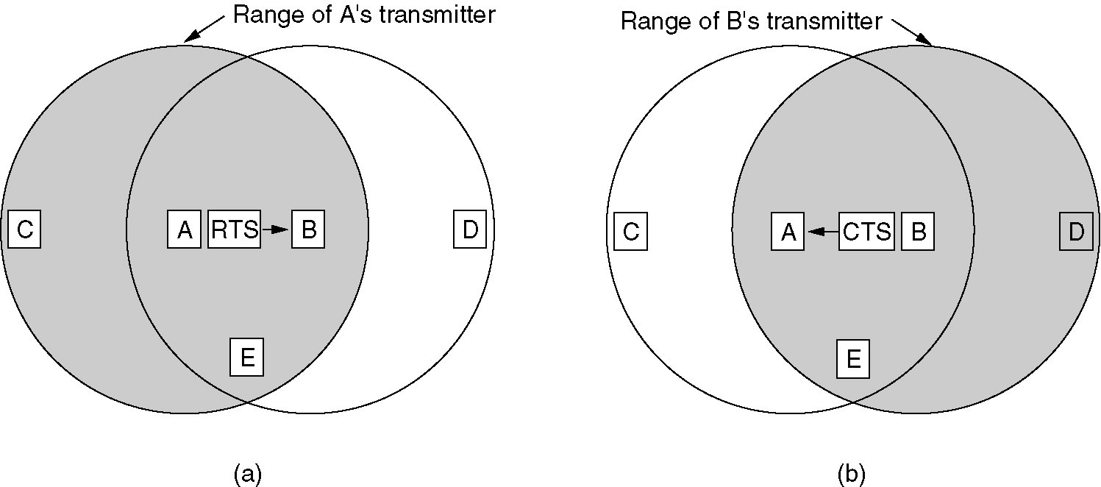
MACA Protocol
The MACA protocol.
A sending an RTS to B.
B responding with a CTS to A.

Slide 56
MACA examples
MACA avoids the problem of hidden terminals
A and C want to send to B
A sends RTS first
C waits after receiving CTS from B
MACA avoids the problem of exposed terminals
B wants to send to A, C to another terminal
now C does not have to wait for it cannot receive CTS from A
RTS
CTS
CTS
A
B
C
RTS
RTS
CTS
A
B
C

Slide 57
References
Book: Prasant Kumar Pattnaik, Rajib Mall, “Fundamentals of Mobile Computing”, PHI Learning Pvt. Ltd, New Delhi – 2012.
Web:http://www.doc.ic.ac.uk/~nd/surprise_96/journal/vol4/vk5/report.html
PPT:
http://www.slideshare.net/tapeshchalisgaonkar1/mobile-computing-25723678
https://cs.uccs.edu/~chow/pub/master/ycai/mobile_computing_mtu.ppt
http://www.slideshare.net/SukumarNayak/snsecurity-architecture-for-mobile-computing-and-iot

